Slide 1
Motion Tracking with Surveillance Cameras
GAO Tianxiang
54774324
Final Year Project Presentation

Slide 2
Background
Objective
Methodology
Performance
Future Work

Slide 3
1.
Background
Why gait analysis?
Why this application?
……

Slide 4
Gait analysis tracks the movement of human to interpret the kinematic activities like walking or running.
-- Perry, J., & Burnfield, J. (2010).
Gait analysis: Normal and pathological function (2nd ed.).

Slide 5
Usage of Analysis Results
Knee Flexion Angle
Diagnosis
Insufficient knee flexion reflects quadriceps weakness.
Flexion contracture of the knee requires extra muscular activity to stabilize the flexion-bearing knee joints.
Treatment
Incorrect spontaneous rest posture (15° to 60° for knee flexion angle of normal samples) renders deformities.

Slide 6
Usage of Analysis Results
Ankle Flexion Angle
Diagnosis
Contracture up to 30° reflects the flaccid paralysis of the tibial anterior muscle.
Treatment
Premature heel lift caused by excessive plantar flexion of the ankle reduces the walking speed to 70% of the normal.

Slide 7
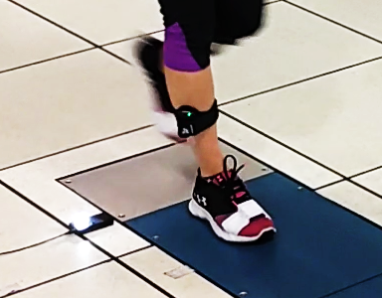
Traditional Methods and Tools
Observation
Electronic Protractor
Infrared Markers
Photoelectric Markers
Motion Sensors
…
Motion Sensor
Pressure Measuring Instrument

Slide 10
Limitations of Previous Work
Device
Universality
Practicability in obtaining parameters
Height
Flexibility in setting the surveillance cameras
Results
Rehabilitation purpose v.s. Entertaining purpose

Slide 11
2. Objectives
Who? What? Why?
……

Slide 12
Accessible
Flexible
Rehabilitative
Attractive

Slide 13
3. Methodology
Skeleton Data Extraction
Image Depth Detection and Calibration
Periodic Information Determination
……

Slide 14
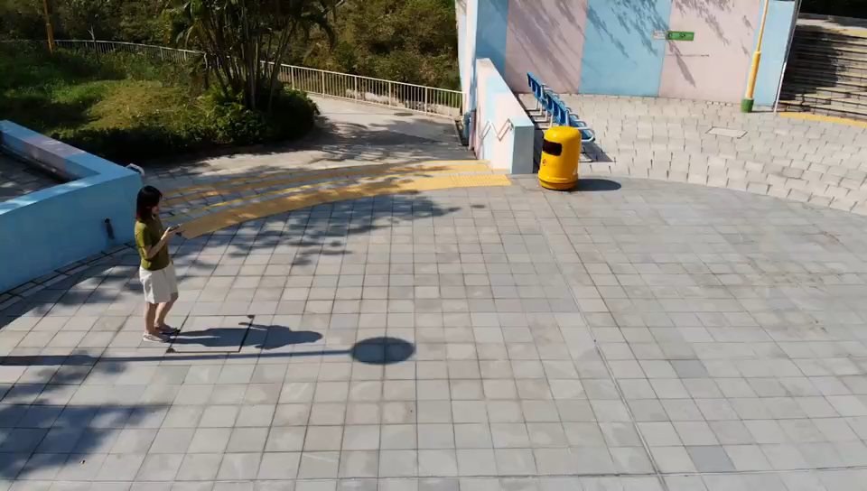
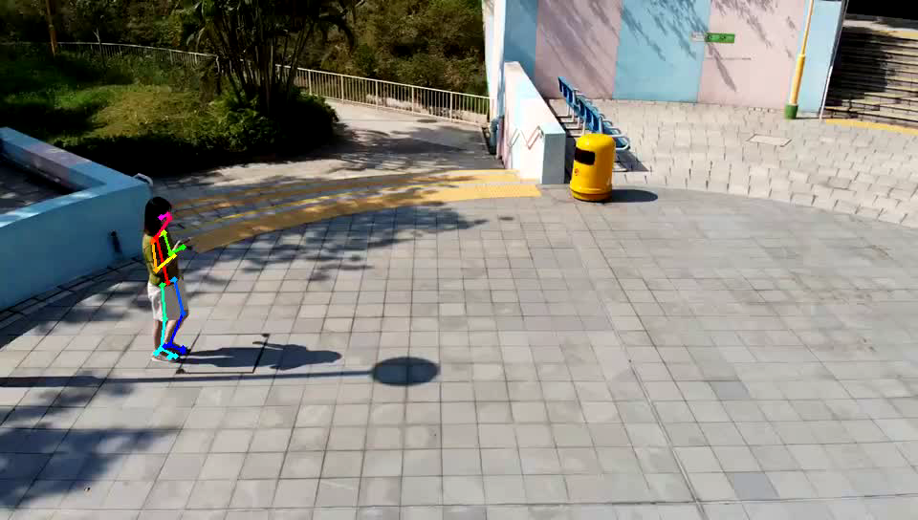
Skeleton Data Extraction –” OpenPose”
Before OpenPose Processing
After OpenPose Processing

Slide 15
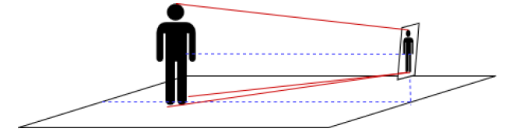
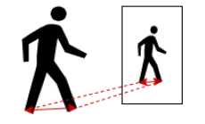

Image Depth Detection – Ratio-Proportion
$$\frac{projected left foot length+projected right foot length}{left foot length+right foot length}= \frac{projected step length}{step length}$$

Slide 16
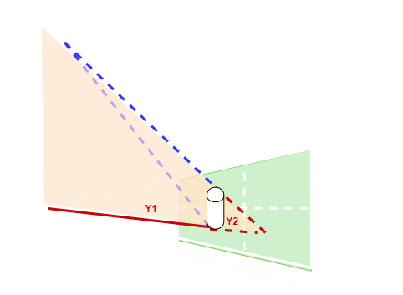
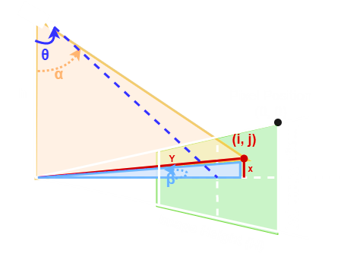



Image Depth Detection – Trigonometry
L
$α=θ+(\frac{H}{2}−j)∙\frac{{FOV}_{v}}{H}$,
$β=\left(\frac{W}{2}−i\right)∙\frac{{FOV}_{h}}{W}$.
$Y=h∙tan\left(α\right)$,
$X=h∙tan\left(β\right)$.
$L=\left(\frac{Y2 −Y1}{Y2}\right)∙h$.

Slide 17
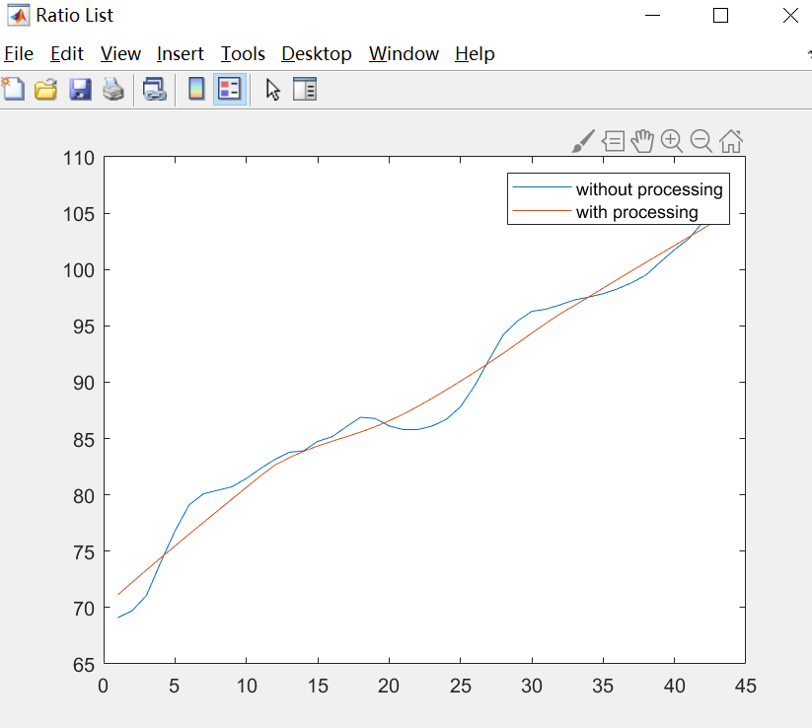
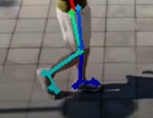
Image Depth Detection – Calibration
Given the length of human feet and the projected joint point positions
Reversely calculate the FOV angle/ pitch angle of the camera using Bisection Method
FOV angle is a Constance
Pitch angle could variate during the walking process

Slide 18
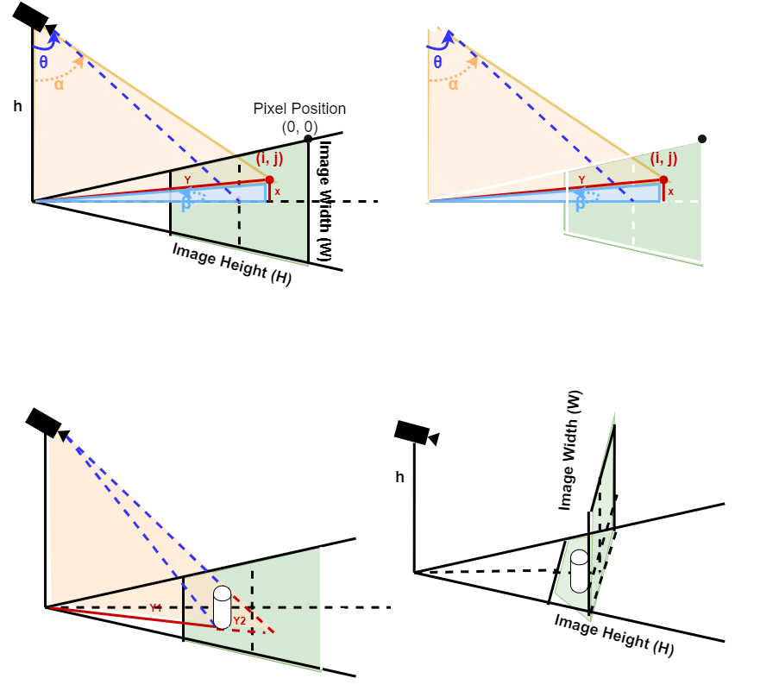
Image Depth Detection – Trigonometry
Surveillance camera set high
Surveillance camera set low

Slide 19
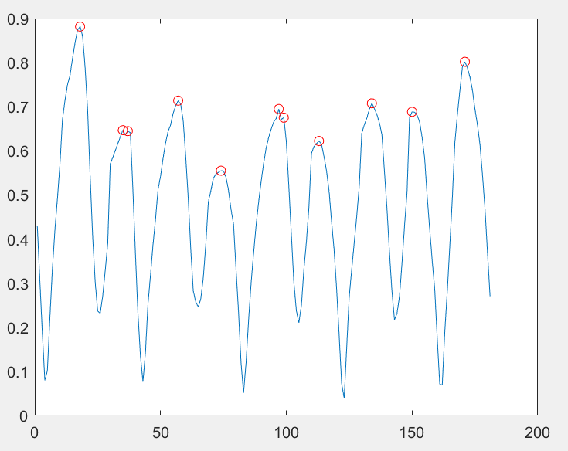
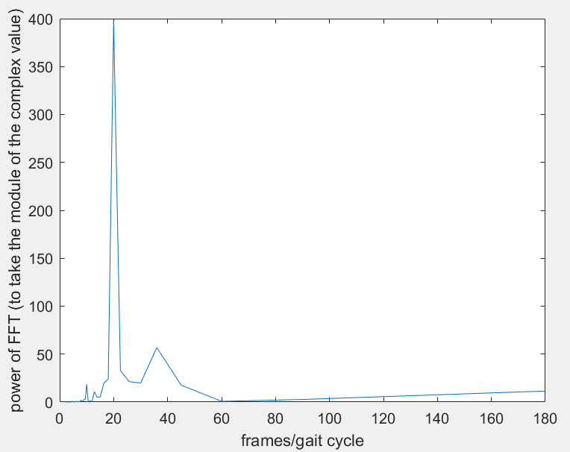
Periodic Information Determination -- Fourier Coefficient
around 20 frames per step
Distance Between Feet
Fast Fourier Transform

Slide 20
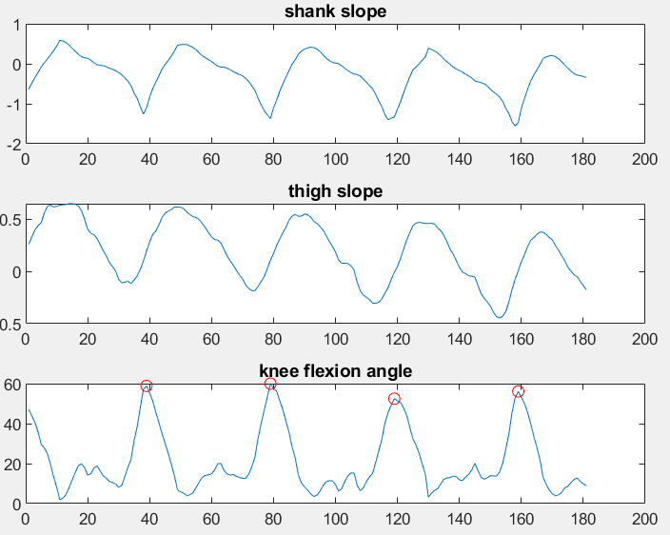
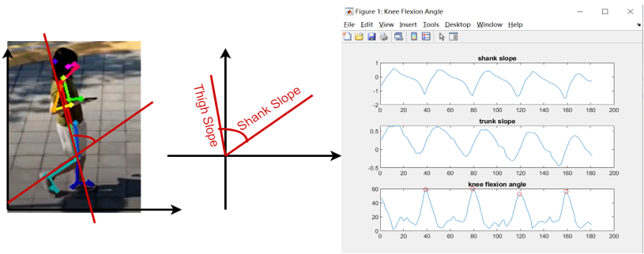
Trajectory Data Extraction

Slide 21
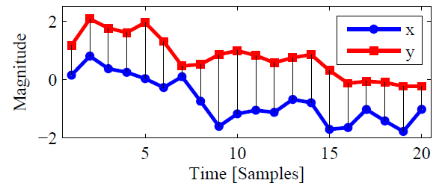
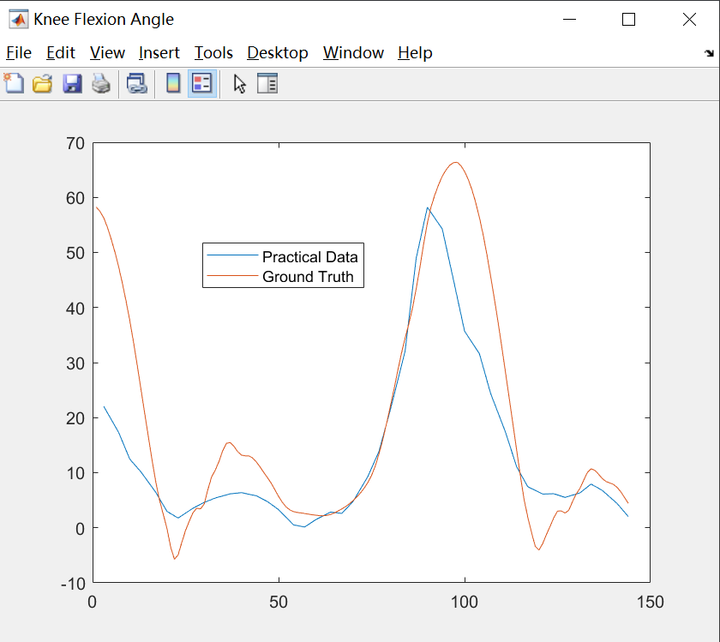
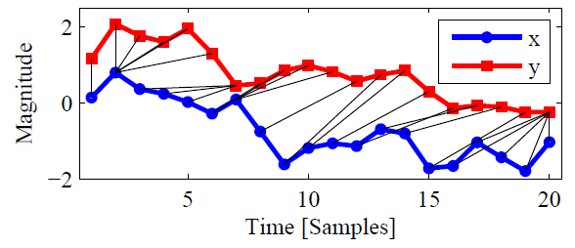
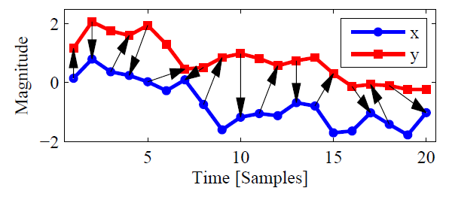
Trajectory Data Evaluation
Euclidean Distance
Dynamic Time Warping
Minimum Jumping Costs

Slide 22
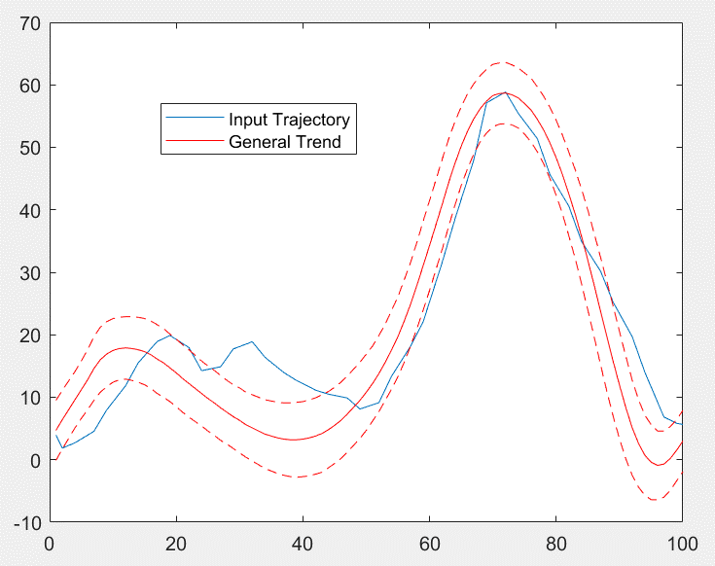
Trajectory Abnormality Detection
During the swing phase, the entire foot should properly off the ground.
This peak flexion angle assists the joint to control the strike absorption as well as stable the body position.

Slide 23
4. Performance
Cadence Information Accuracy
Trajectory Data Dissimilarity
Trajectory Abnormality Analysis
……

Slide 24
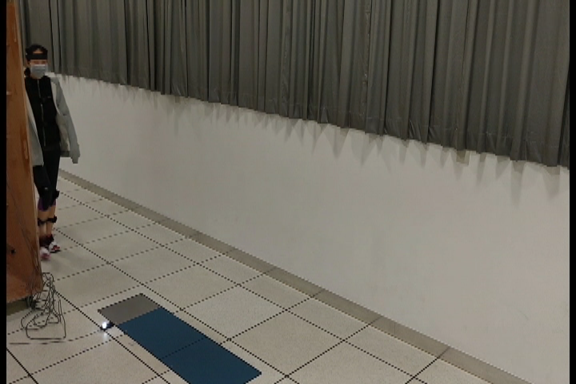
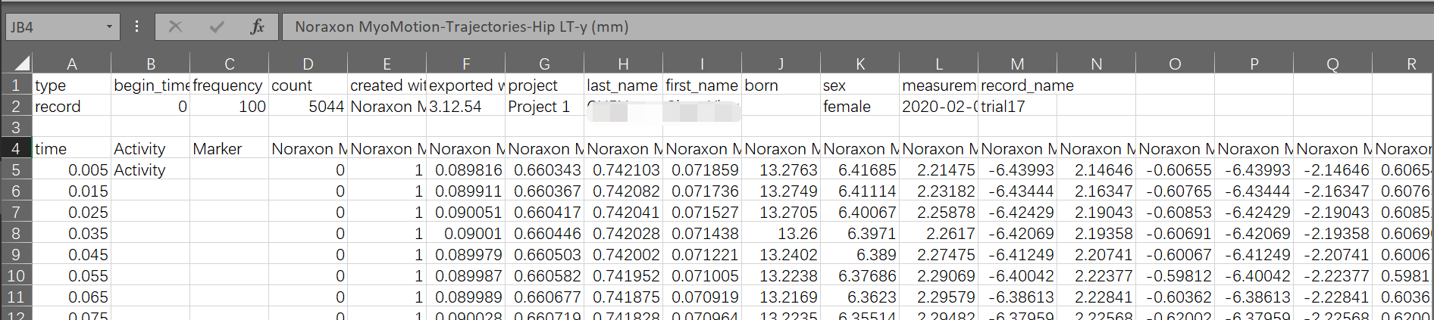
Data Set – Videos and Motion Sensors
10 Cases shot by mobile phone
2 Cases shot by drone
Motion Sensors
Wearable Devices

Slide 25
Cadence Information Accuracy
Accuracy | Speed (m/s) | Accuracy of Speed | Accuracy of Stride Length | Accuracy of Frequency
Case 9 | 0.31 | 68.71% | 71.29% | 71.03%
Case 8 | 0.62 | 87.92% | 90.48% | 88.08%
Case 19 | 1.3154 | 99.34% | 95.08% | 93.94%
Case 13 | 1.5394 | 77.91% | 90.19% | 87.61%
Case 21 | 1.5756 | 81.67% | 89.55% | 91.95%
Case 20 | 1.6327 | 97.36% | 97.17% | 93.24%
Case 14 | 1.6781 | 91.88% | 93.25% | 97.73%
Case 16 | 1.6875 | 95.35% | 93.85% | 96.26%
Case 15 | 1.7048 | 97.96% | 97.00% | 95.11%
Case 18 | 1.8528 | 92.61% | 86.89% | 98.56%
Case 12 | 1.9101 | 79.74% | 88.38% | 95.99%
Case 17 | 1.9227 | 76.17% | 64.22% | 83.59%
Average |  | 87.22% | 88.11% | 91.09%
Notes:
80% people interested in how fast they walk

Slide 26
Trajectory Data Dissimilarity
Dissimilarity | Euclidean Distance | Fourier Coefficient | Dynamic Time Warping | Minimum Jump Costs
Case 12 | 2.1728 | 6.4694 | 17.105 | 0.005217
Case 13 | 1.6228 | 6.3242 | 9.5708 | 0.00796
Case 14 | 1.2511 | 4.715 | 10.593 | 0.001197
Case 15 | 1.8473 | 5.6681 | 16.027 | 0.000496
Case 16 | 1.828 | 3.9837 | 13.2 | 0.15657
Case 17 | 2.5124 | 6.7 | 30.766 | 0.002621
Case 18 | 2.4575 | 5.7472 | 13.486 | 0.000884
Case 19 | 2.7328 | 7.0306 | 24.337 | 0.000926
Case 20 | 2.9312 | 5.3518 | 20.419 | 0.001049
Case 21 | 2.0845 | 3.5632 | 17.855 | 0.000233
Average | 2.14404 | 5.55532 | 17.33588 | 0.017715
Variance | 0.246155 | 1.214909 | 37.86154 | 0.002148

Slide 27
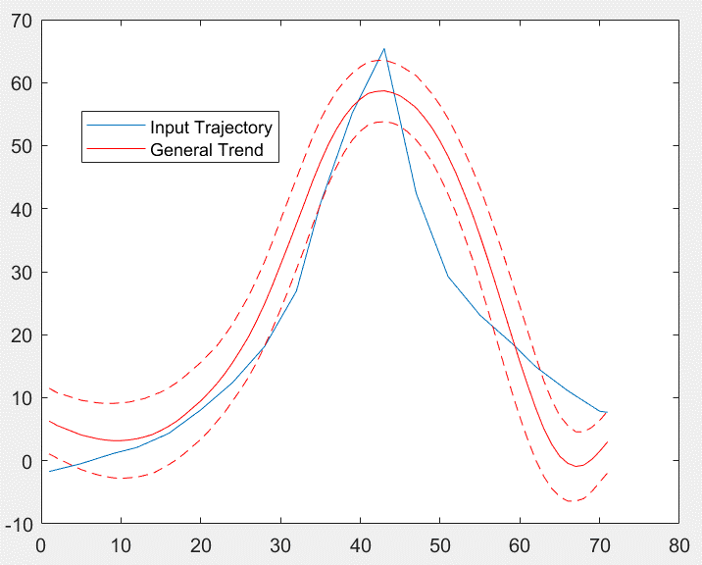
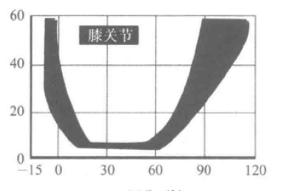
Trajectory Abnormality Analysis
Knee
Stress (cmH2O)
Knee Flexion Angle (degree)

Slide 28
5. Future Work
Ankle Flexion Angle
Real-Time
……

Slide 29
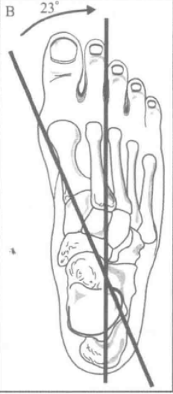
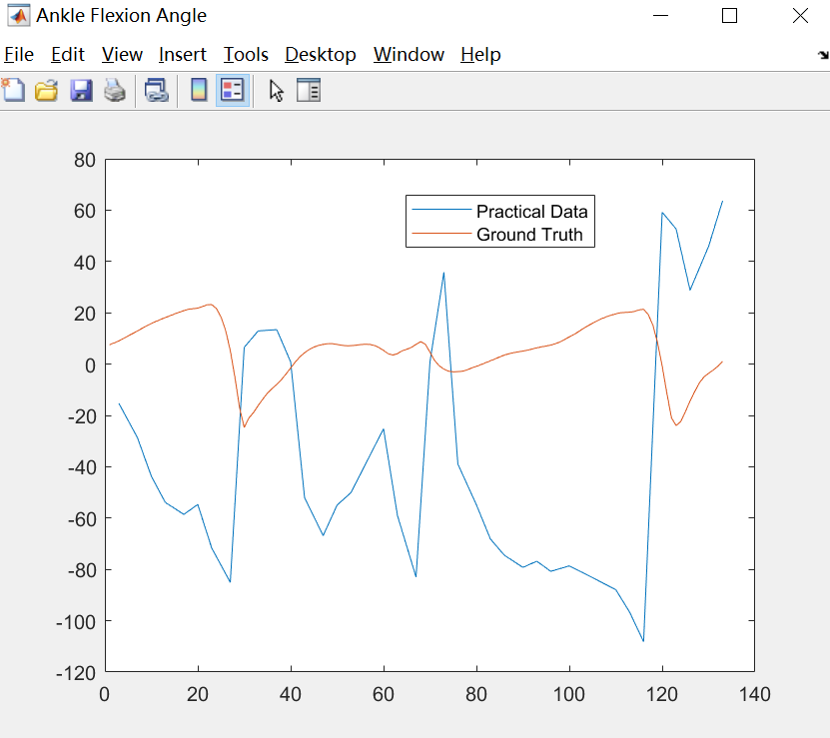
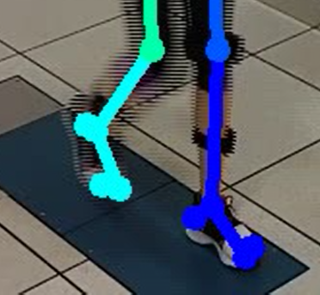
Ankle Flexion Angle
Single Camera
Sagittal Plane Only
OpenPose Marking Error
Inaccurate Angle Determination
Low Shooting Rate
Tiny Features Overlooked

Slide 30
Real-Time Application

Slide 31
6. Conclusion

Slide 32
Necessity of Gait Analysis
Methodology & Performance
Future Work
A flexible and accessible gait analysis tool is not only important in rehabilitation but also promising in the market.
Quantify the kinematic activities and analysis for rehabilitation purpose.
Improve the accuracy in trajectory data and use professional suggestions to supervise the tool.

Slide 33
Reference
Cao, Z., Hidalgo, G., Simon, T., & Wei, Y. (2019, May 30). OpenPose: Realtime Multi-Person 2D Pose Estimation using Part Affinity Fields. Retrieved from https://arxiv.org/abs/1812.08008
Perry, J., & Burnfield, J. (2010). Gait analysis: Normal and pathological function (2nd ed.). Thorofare, NJ: SLACK.
Salih, Y., & Malik, A. S. (2012, August 16). Depth and Geometry from a Single 2D Image Using Triangulation. Retrieved from https://ieeexplore.ieee.org/document/6266436
Serrà, J., & Arcos, J. L. (2014, January 16). An Empirical Evaluation of Similarity Measures for Time Series Classification. Retrieved from https://arxiv.org/abs/1401.3973v1
Shi, Y. (2019). Gait analysis with Drone. Retrieved from http://dspace.cityu.edu.hk/handle/2031/9164

Slide 34
Q&A

Slide 35
Thank You!

